Slide 1


Advanced HTML5 Elements and Final Project
Presenter: Web Development Team

Slide 2


Content
1. Understanding Web Workers
2. Responsive Images in HTML5
3. Enhancing Accessibility with HTML5
4. Final Project Overview

Slide 3

Section 1
Understanding Web Workers

Slide 4

Introduction to Web Workers
Understanding Web Workers
Web Workers are a powerful feature in HTML5 that enable multi-threading in web applications, allowing scripts to run in the background without interrupting the user interface. This is particularly useful for performing heavy computations or processing large data sets, as it enhances performance and responsiveness. By offloading tasks to a worker thread, developers can ensure a smoother user experience, making applications more efficient and capable of handling complex operations seamlessly.

Slide 5
Benefits of Using Web Workers
Pros
Cons
Improved performance
Increased complexity
enhances responsiveness
debugging challenges
offloads heavy tasks
limited communication
prevents UI freezing
potential overhead
supports multi-threading
browser compatibility issues
boosts user experience
resource management concerns

Slide 6


Implementing a Simple Web Worker
01
02
03
Creating a Worker Instance
Handling Messages
Terminating Workers
Use the `onmessage` event handler to receive messages from the worker. This is crucial for communication between the main thread and the worker, allowing data to be sent back and forth efficiently.
To implement a simple web worker, instantiate it using the `Worker` constructor with the path to the JavaScript file. This allows the main thread to delegate tasks to the worker, enabling background processing without blocking the UI.
When a worker is no longer needed, call the `terminate()` method to stop its execution. This helps free up resources and ensures that background tasks do not continue running unnecessarily, maintaining optimal performance.

Slide 7



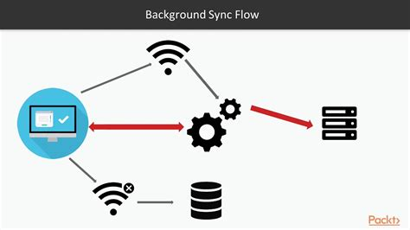
Use Cases for Web Workers in Web Development
Data Processing Tasks
Real-time Applications
Background Synchronization
Web Workers are ideal for handling large data processing tasks, such as image manipulation or data analysis, without blocking the main thread, ensuring a responsive user interface during intensive operations.
In applications like chat or gaming, Web Workers can manage real-time data updates and calculations, allowing seamless interactions and updates without interrupting the user experience or causing lag.
Web Workers can perform background synchronization tasks, such as fetching data from APIs or syncing local storage, enabling applications to update content efficiently while users continue interacting with the interface.

Slide 8

Section 2
Responsive Images in HTML5

Slide 9

The Importance of Responsive Images
Enhanced User Experience
Responsive images adapt to different screen sizes and resolutions, ensuring optimal loading times and visual quality across devices, which significantly improves user engagement and satisfaction.
Performance Optimization
By utilizing the `<picture>` element and `srcset` attribute, developers can serve appropriately sized images, reducing bandwidth usage and enhancing page load speed, crucial for mobile users.
SEO Benefits
Implementing responsive images contributes to better search engine rankings as it improves site performance and user experience, factors that search engines prioritize in their algorithms.

Slide 10


The `<picture>` element allows developers to specify multiple image sources for different display conditions, such as screen size and resolution, ensuring that the most appropriate image is loaded based on the user's device capabilities.
Using the <picture> Element
By using the `<source>` element within `<picture>`, developers can implement art direction, enabling them to serve entirely different images for varying viewport sizes, thus enhancing visual presentation and user experience across diverse devices.

Slide 11
Implementing srcset for Different Viewports
01
02
03
Understanding srcset Attribute
Syntax and Usage
Combining with Sizes Attribute
The `srcset` attribute allows developers to specify multiple image sources for different screen resolutions and sizes, ensuring that the browser selects the most appropriate image based on the device's capabilities and viewport dimensions.
The syntax for `srcset` includes a list of image URLs followed by their respective width descriptors (e.g., `small.jpg 640w, large.jpg 1024w`), enabling responsive design by loading images that match the display conditions, thus optimizing performance and user experience.
When used alongside the `sizes` attribute, `srcset` can provide additional context about how much space an image will take up in different viewport scenarios, allowing browsers to make more informed decisions about which image to load for optimal rendering.

Slide 12
Best Practices for Responsive Images
Leveraging srcset for Optimization
Utilizing the <picture> Element
Use the `srcset` attribute to define a set of images with varying resolutions, allowing the browser to select the most appropriate one based on the user's display characteristics. This practice not only optimizes bandwidth usage but also accelerates page load times, crucial for maintaining user engagement on mobile devices.
Implement the `<picture>` element to provide multiple image sources tailored for different screen sizes and resolutions. This approach enhances loading efficiency and visual quality, ensuring that users receive the best possible image based on their device capabilities, ultimately improving user experience.

Slide 13
Section 3
Enhancing Accessibility with HTML5

Slide 14

Introduction to Accessibility in Web Design
Importance of Accessibility
Accessibility in web design ensures that all users, including those with disabilities, can navigate and interact with web content effectively, promoting inclusivity and compliance with legal standards such as the Web Content Accessibility Guidelines (WCAG).

Slide 15

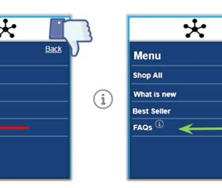
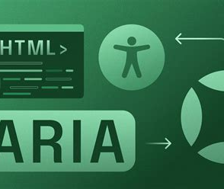
Utilizing ARIA Attributes
Understanding ARIA Roles
Implementing ARIA States and Properties
Best Practices for ARIA Usage
ARIA roles provide semantic meaning to HTML elements, enhancing accessibility by informing assistive technologies about the purpose of elements, such as buttons, navigation, and regions within a web application.
Utilize ARIA states and properties to convey dynamic changes in the user interface, such as `aria-expanded` for dropdowns or `aria-checked` for checkboxes, ensuring users with disabilities receive real-time updates on element status.
Follow best practices by using ARIA attributes only when native HTML elements do not suffice; overusing ARIA can lead to confusion. Always ensure that your implementation enhances accessibility without compromising the user experience.

Slide 16

Implementing Semantic HTML
Use semantic HTML elements like `<header>`, `<nav>`, `<main>`, and `<footer>` to provide meaningful structure to your web pages, which aids screen readers in understanding the layout and navigation of the content, thereby enhancing accessibility for users with disabilities.
Creating Accessible HTML Elements

Slide 17

Testing for Accessibility Compliance
Conducting Accessibility Audits
Regularly perform accessibility audits using tools like WAVE or Axe to identify and rectify compliance issues, ensuring that all users, including those with disabilities, can effectively navigate and interact with your web content.

Slide 18
Section 4
Final Project Overview

Slide 19

Project Objectives and Goals
Define Project Scope
Establish clear objectives for the final project by identifying key features of advanced HTML5 elements to be implemented, ensuring alignment with user needs and technical feasibility while promoting best practices in web development.

Slide 20
Utilizing New HTML5 Elements
Incorporate advanced HTML5 elements such as `<canvas>`, `<video>`, and `<audio>` to enhance interactivity and multimedia capabilities in your final project, allowing for dynamic graphics, rich media playback, and improved user engagement through innovative web experiences.
Integrating Advanced HTML5 Features

Slide 21
Presentation and Feedback Process
01
02
03
Structured Presentation Guidelines
Feedback Mechanism
Reflection and Iteration
Establish clear guidelines for presenting the final project, including time limits, key points to cover, and the use of visual aids to enhance understanding and engagement during the presentation.
Implement a structured feedback process that encourages constructive criticism from peers and instructors, focusing on specific aspects such as design, functionality, and user experience to foster improvement and learning.
Encourage students to reflect on the feedback received and iterate on their projects accordingly, promoting a growth mindset and continuous improvement in their web development skills through practical application of suggestions.

Slide 22
Thank You
Contact: webdevteam@example.com

